Slide 1
APIs With Swag(ger) Gary DeReese
Notes:
Good evening! My name is Gary DeReese – I’m the Director of API Development with Ctuit Software. Tonight we’re gonna talk about APIs with Swag(ger).

Slide 2
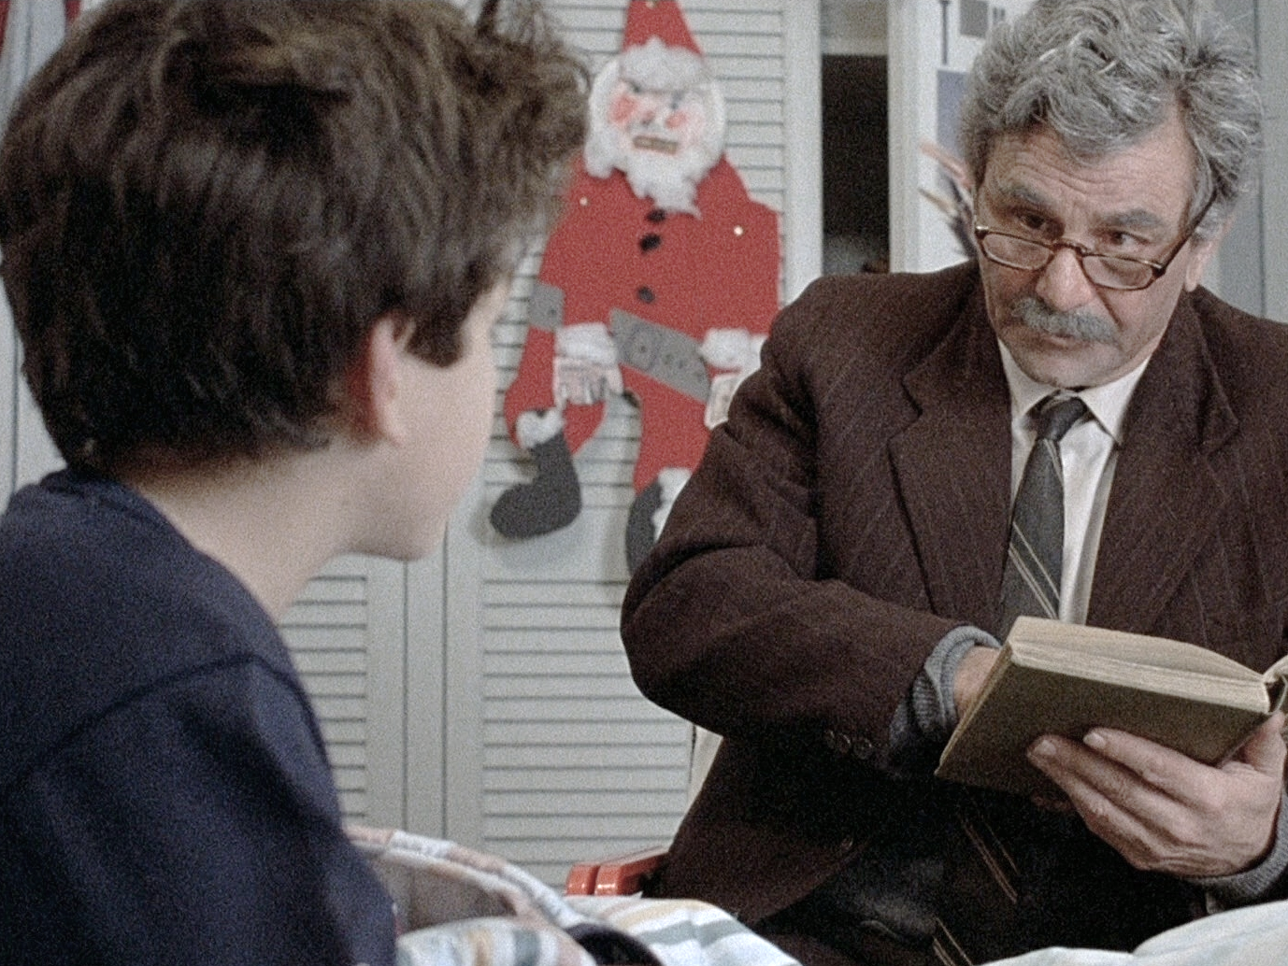
Story Time
Notes:
I’ll jump right in with a little story time. I’m a nostalgia junkie myself, so I’ll take us on a little trip through a bit of the 80s to help set things up.

Slide 3
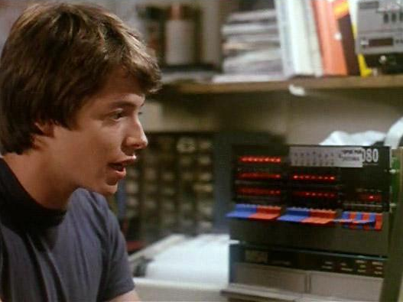
Notes:
Anyone recognize him? David Lightman
Once he got word of Protovision’s big upcoming 1983 holiday video game lineup, he couldn’t wait until Christmas to play them – he wanted to play them NOW.
The task was simple – hack Protovision’s mainframe, and the all those unreleased games would be at his fingertips.
Reams of dot matrix printouts and cases of 12-oz cans of Tab later, he finally gets in!

Slide 4

Notes:
David and his classmate Jennifer huddle closely around the monochrome CRT buzzing with excitement.
They start up a game on a list of many…Global Thermonuclear War. They punched up missile coordinates like 2 regular war mongers, never skipping a beat. They were having a great time!
One problem…

Slide 5
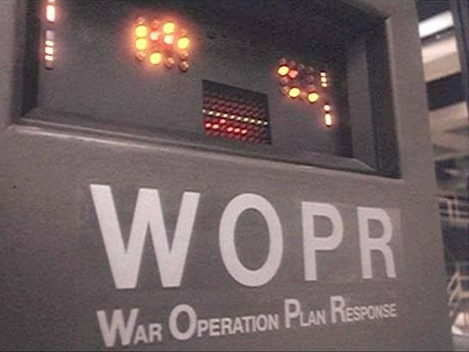
Notes:
…he wasn’t actually connected to the video game company’s mainframe.

Slide 6

Notes:
The whole thing was actually a big mess.
It ended up working out just fine, but perhaps David would have avoided a lot of trouble if he was able to more better understand how to interface with WOPR in the first place.
If WOPR would have been able to give David more information about what Global Thermonuclear War actually was, how it is used and what the impacts are of actually running it, he might have realized he was in the wrong system, and wouldn’t have had to take that ride down to NORAD in the white van with blacked-out windows.

Slide 7

Notes:
Next, meet Alan Bradley, software engineer for Encom.
Under the radar of a power-hungry CEO carrying out a plan to incorporate every engineer’s intellectual property into a giant, dictatorial computer system, he builds a program that will help other software engineers protect their own work and keep the system free.
Anyone know what the name of that program was?

Slide 8

Notes:
Tron!

Slide 9

Notes:
Now that Tron was ready to free the grid, the challenge in front of Alan was to make sure other engineers were able to discover Tron and his capabilities and how to leverage his strengths to accomplish their own goals.
Warping back to reality in the 21st century, and with those lessons learned and scenarios in mind…

Slide 10

Swagger
Notes:
…that’s where Swagger comes in.

Slide 11
What is Swagger?
Uses JSON to define a standard, language-independent interface to a REST API using JSON
Allows humans and software to discover an API’s capabilities
Lowers barrier of entry for interfacing with the API’s endpoints
Notes:
Swagger is a JSON document that defines a standard, language-independent interface to REST APIs
that allow both humans AND computers to discover and understand the capabilities of an API without needing source code or written documentation.
When properly defined, an API consumer can get bootstrapped quickly for using it with minimal effort

Slide 12
First Look at Swagger
Path
"/pets": { "get": { "description": "Returns all pets from the system that the user has access to", "produces": [ "application/json" ], "responses": { "200": { "description": "A list of pets.", "schema": { "type": "array", "items": { "$ref": "#/definitions/pet" } } } } } }
Operation
Schema
Notes:
Here’s a quick first look at a snip of what kind of stuff ends up in a Swagger document:
It describes an API in terms of
paths (endpoints, correspond to HTTP URLs)
operations (actions that can be performed, correspond to HTTP methods), and
schemas (structured data used as inputs and/or outputs),
Is anyone familiar with SOAP web services? The tie-in for you guys is that Swagger is like WSDL without the SOAP and with more JSON.

Slide 13
Swagger Tools
Notes:
Around using Swagger, there are a couple different types of tools developers can use to accomplish different goals. One of them is…

Slide 14


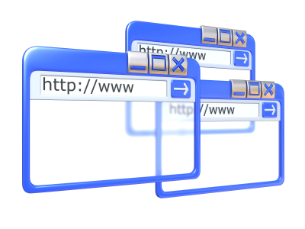
Swagger UI
Notes:
Let’s say you develop an API and you have a user that wants to
consume your API, but he doesn’t know what the endpoints are or the inputs and outputs from that API.
(clear arrow)
If the API exposes a Swagger document, you or someone else can
create a Swagger UI that requests the Swagger document and presents the information in a more readable, user-friendly way.
The user can refer to the Swagger UI as documentation, but it also provides an interface for
trying out the various endpoints on the API, so he can play with them until it clicks

Slide 15
Demo swagger-ui
Notes:
Let’s take a look at an example Swagger document and how a Swagger UI implementation uses that to generate a full API documentation page as well as facilities for trying out the endpoints.
(demo)
That’s great! Now that we’ve just gotten a taste of what Swagger can do for us…

Slide 16
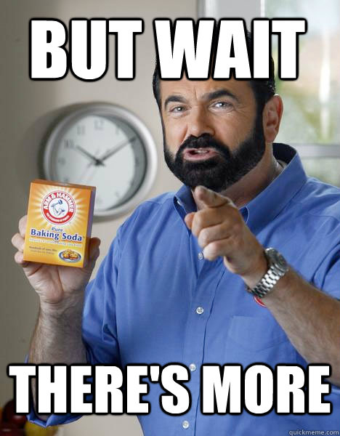
Notes:
We’re gonna take it up a notch and talk about Swagger code generation!

Slide 17


Swagger Codegen
Notes:
Let’s say you are a consumer of an API that exposes a Swagger and you want to ramp up quickly to coding against it.
Since the API exposes a Swagger, which is digital (JSON), you could in theory have
another program read in the API metadata and
generate and SDK for you that you can use to
interface with the API straight away.

Slide 18
Demo swagger-js
Notes:
If you are working on a web browser application, you can use a tool called swagger-js to help you here.
I’ll show you an example of how to use swagger-js to consume a Swagger make a clean set of JavaScript objects to use that encapsulate and manage all the API communication for us.
(demo)

Slide 19
Further Reading
Swagger swagger.io
swagger-ui/swagger-js github.com/swagger-api
NSwag (Swagger code generation for .NET) github.com/NSwag
Swashbuckle (Swagger generation for ASP.NET Web API) github.com/domaindrivendev/Swashbuckle
Notes:
Hopefully I’ve given you just enough of Swagger to wet your whistle. If you’re interested in what you’ve learned about Swagger so far, here’s some resources I recommend for further reading.

Slide 20

Swag 4 Life
Notes:
Thank you ☺

